Slide 1
CHIKV nsP3 Macrodomain crystallographic fragment screening
Jasmin Aschenbrenner
Daren Fearon
Warren Thompson
Max Winokan
Diamond Light Source

Slide 2
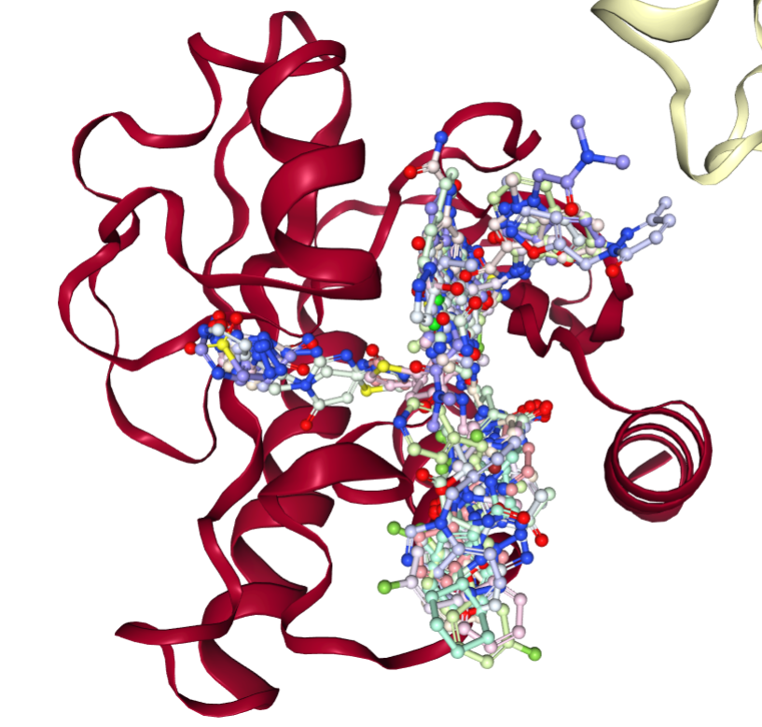
Crystallographic fragment screen – summary
Fragments soaked: 1385 (DSi-Poised Library, Minifrags, Fraglites, Peplites, York 3D, SpotXplorer, Enamine Essential Fragments)
Datasets successfully collected and processed: 1082 datasets
Hit identification: 109 fragment hits (66 in active site, 43 in sub-sites close to the active site)
PoseButcher site analysis:
Ribose-binding site: 42 observations
Phosphate-binding site: 26 observations
Oxyanion site: 61 observations
Adenine site: 188 observations
Fragalysis upload: CHIKV_Mac: Fragalysis

Slide 3
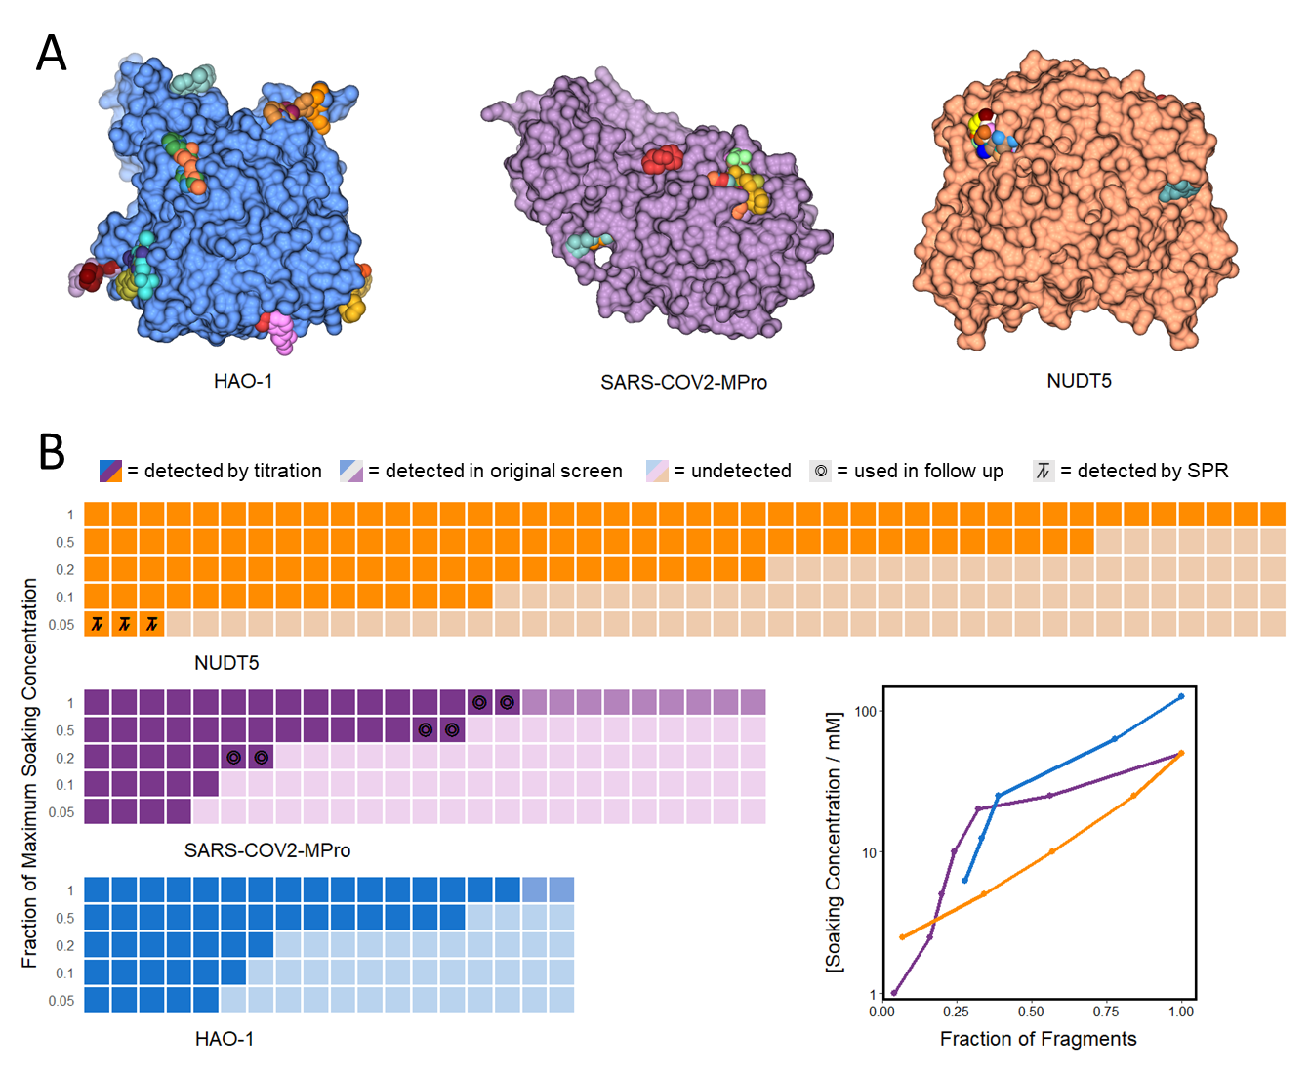
Follow-up experiments: Fragment titration
Titrations of fragments to estimate their affinity to CHIKV nsP3 macrodomain
>109 fragment poses identified
Which ones to prioritise for making follow-up compounds?
Do any fragments that bind more strongly?
Fragment titrations:
Soaking previous identified fragments hits against crystals at a series of diminishing concentrations.
Analysing through XCE and PanDDA2 to highlight fragments that are still meaningfully incorporated by protein at low micromolar concentrations.
Which fragments to test?

Slide 4
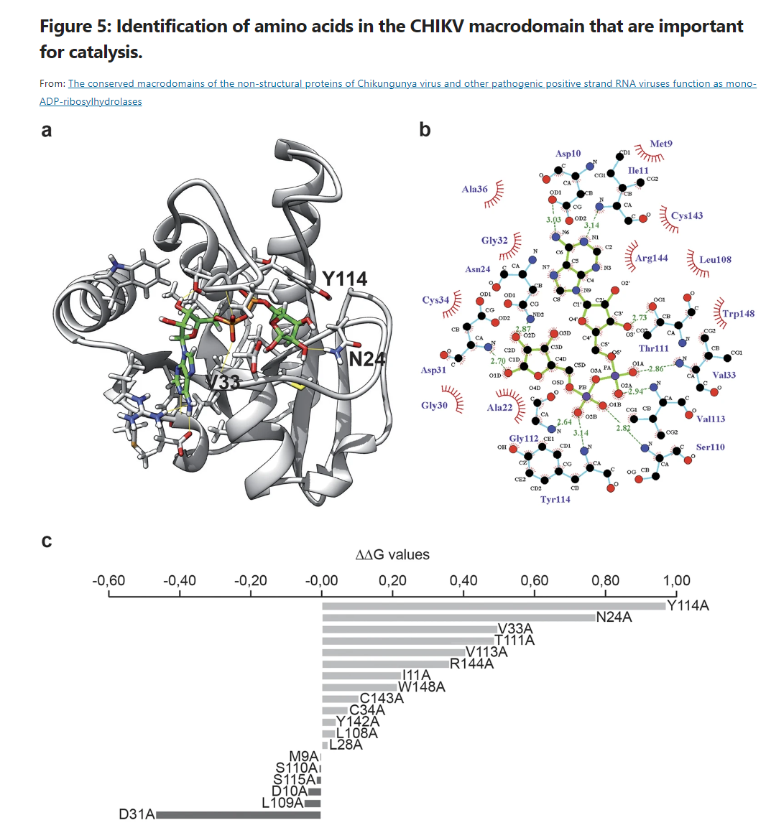

Identification of key amino acids in the CHIKV macrodomain that are important for catalysis
L28
D10
Residues to target
N24
Residues to avoid
D31
R144
V33
Y114
L109
V113
L108
S110
T111
W148
The conserved macrodomains of the non-structural proteins of Chikungunya virus and other pathogenic positive strand RNA viruses function as mono-ADP-ribosylhydrolases | Scientific Reports (nature.com)

Slide 5
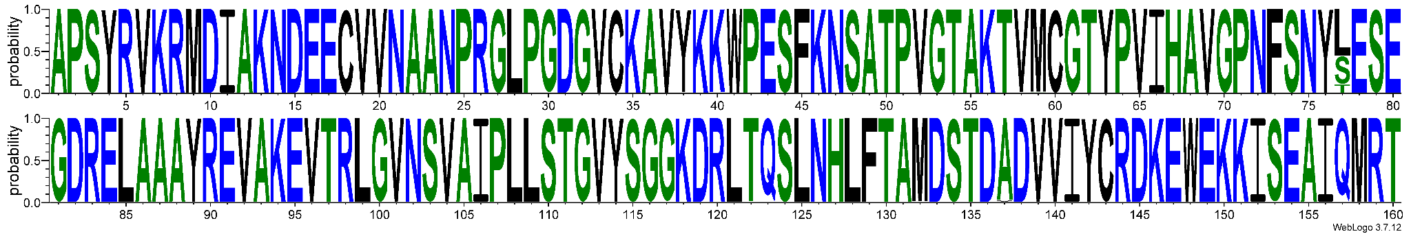
Sequence conservation of CHIKV nsP3 macrodomain
Sequence analysis of 1616 CHIKV nsP3 macrodomain sequences *highly conserved - found in all analysed sequences
Residues to avoid/Residues to target
M9(K)
L28(P)
V33
I11(F)
D10
N24
D31(N/G)
C34
*** * * * * * ******* ** **** * * *** * *** * * ******** ** ** *
******* ** ** * * * ***** *** ** *** *** * **** *** **** ** * * * **
L108
Y114
Y142(C)
R144
W148
T111
L109
S115
C143
V113(A)
S110
PROMALS3D - PROfile Multiple Alignment with Local Structure and 3D structure (swmed.edu) WebLogo: A Sequence Logo Generator (cshlp.org), coloured by hydrophobicity https://drive.google.com/drive/folders/17w3RbHNS9toXa5vFYN7BwTx5GA7qpHqG?usp=drive_link

Slide 6
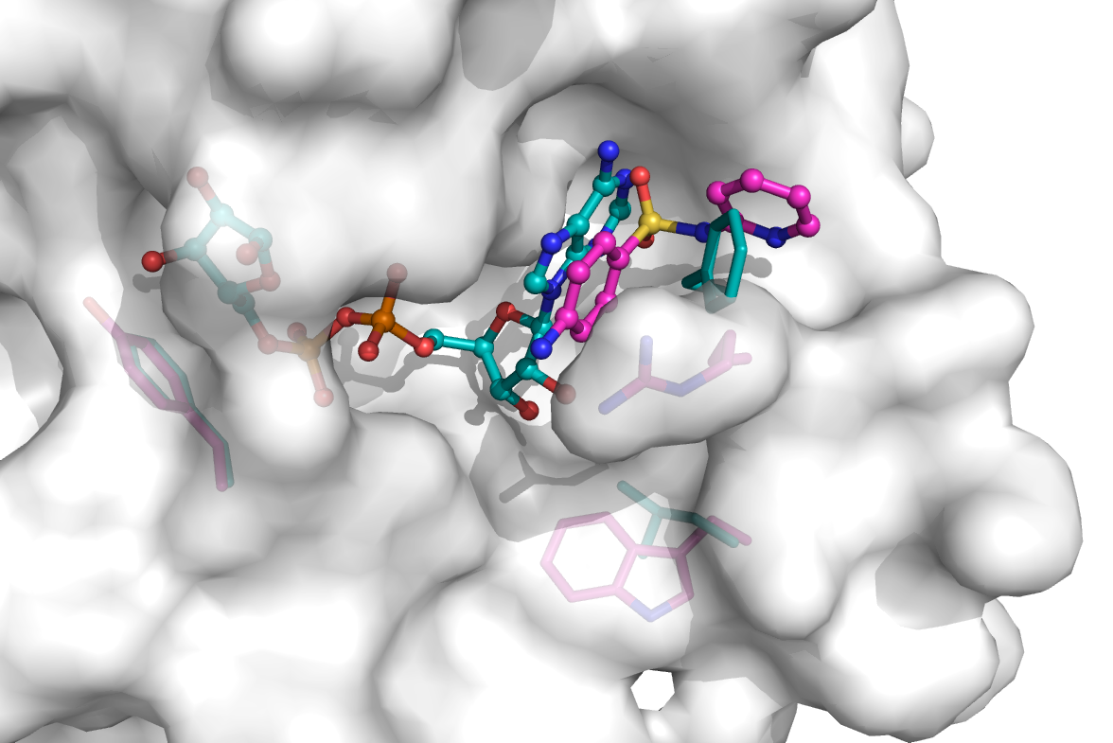
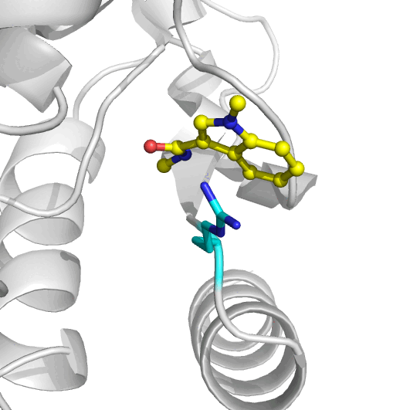
Arg144 movement reveals cryptic pocket
Residue adopts different conformation dependent on ligand binding.
SARS-CoV-2 nsp3 macrodomain (7kqp) & cx0289a (Z104492884)

Slide 7
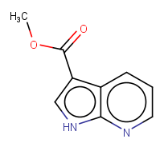
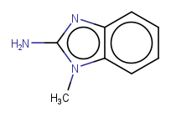
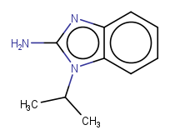
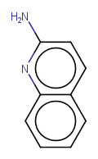
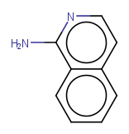
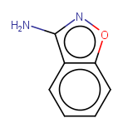
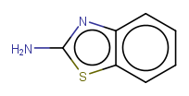
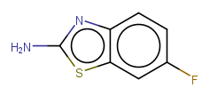
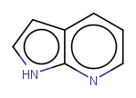
Common scaffolds - adenine sub site
Aminoquinoline/
benzoxazole
Pyrrolo
pyridine
Amino benzimidazole/ benzothiazole
x1203
x1299
x1278
x1440
x1338
x1288
x1271
x1410
x1402

Slide 8
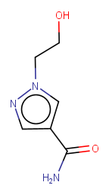
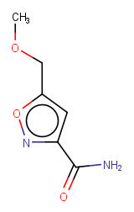
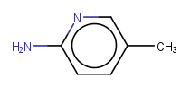
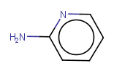
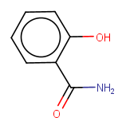
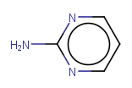
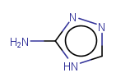
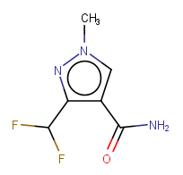
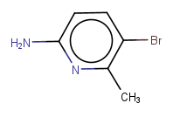
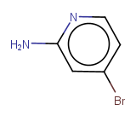
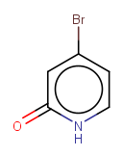
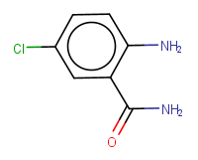
Common scaffolds - adenine sub site
Aminopyridine like
Amides
x1406
x1116
x1445
x0477
x0404
x1132
x1123
x1454
x1075
x1076
x0394
x1372

Slide 9
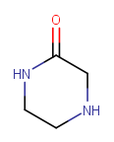
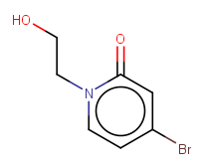
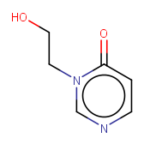
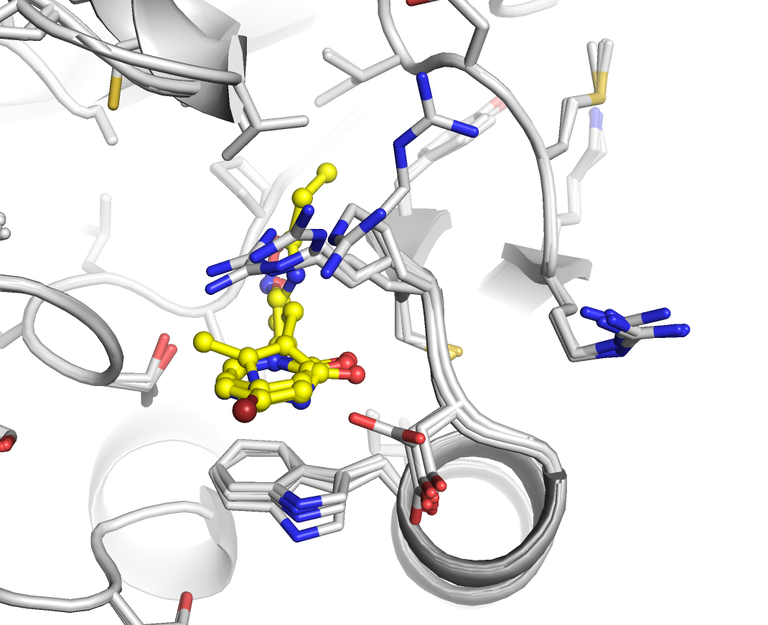
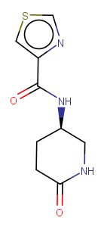
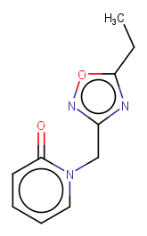
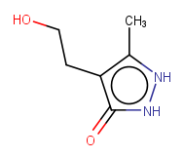
Common scaffolds - Oxyanion hole
x1131
x1091
x0314
x0300
x0316
x0317

Slide 10
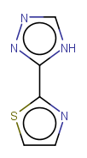
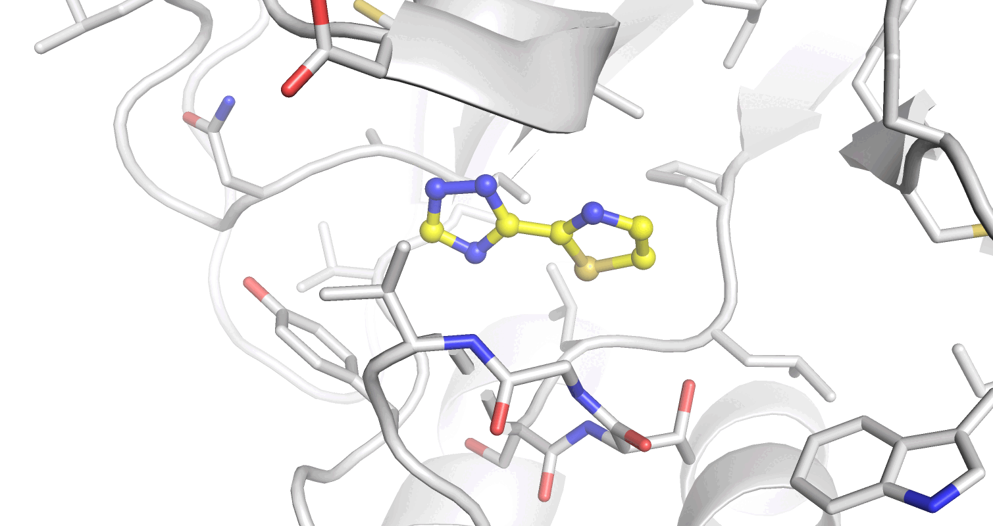
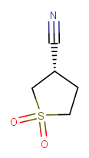
Phosphate and distal ribose site
Limited number of hits in this region but Phe114 key residue
Ligand-induced Thr111 peptide flip observed in some examples
x0281
x1182

Slide 11
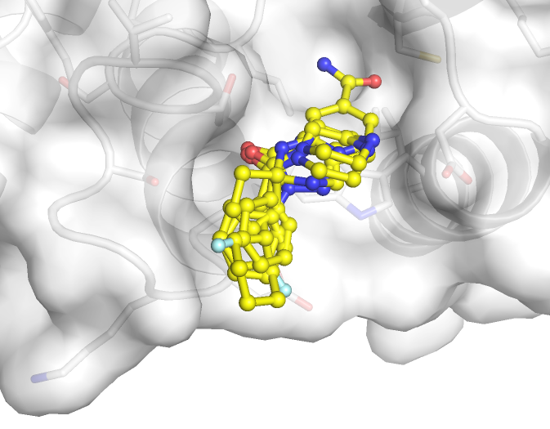
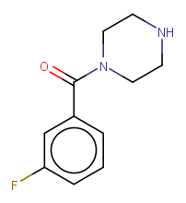
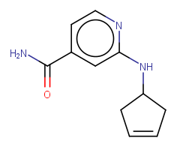
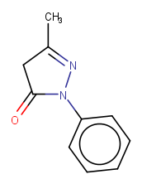
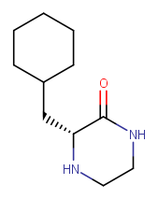
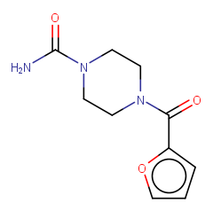
Trp148 binding site ligands
x0585
x0543
x0760
Solvent exposed vector - attractive for developing targeted degraders?
x0436
x0441

Slide 12
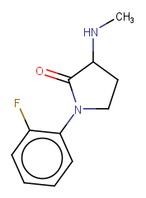
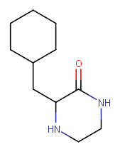
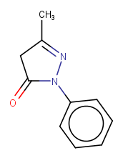
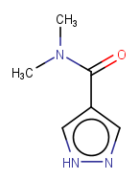
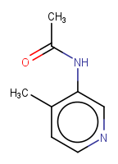
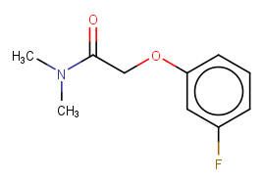
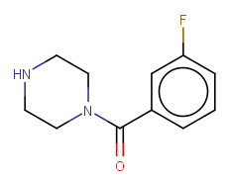






Follow-up experiments: Combi-soaks
Simultaneously soaking a range of W148-binding fragments alongside cx0281
x0281
x0305 x0398 x0436 x0540 x0585 x0732 x0760
W148-binding fragments that induce peptide flip: https://fragalysis.diamond.ac.uk/viewer/react/projects/97/92
x0316 x0317 x0441 x0543
W148-binding fragments without peptide flip: https://fragalysis.diamond.ac.uk/viewer/react/projects/72/67

Slide 13











ASAP SARS-CoV-2 nsp3 Mac1 toolbox
Compounds available for shipment from Enamine
Strong cellular engagement signal seen for 2 out of 3 compounds tested by CETSA at 30 μM in HEK293 cells
Could not identify a cell model that shows Mac1 induced antiviral activity
ASAP-0011198 shows promise for in-vivo efficacy experiments but lead optimization required (high clearance)
Alternative mode of action (targeted degradation) may be attractive?
ASAP-0011446
Mac1 IC50 / μM : 0.021
logD (7.4) : 3.1
KSOL / μM : 65
MDCK A->B / 10⁻⁶ cm s⁻¹: 4.4
MLM,HLM / μL min⁻¹mg⁻¹: 202,273
Xtal structure ✅
ASAP-0011198
Mac1 IC50 / μM : 0.065
logD (7.4) : 1.6
KSOL / μM : 392
MDCK A->B / 10⁻⁶ cm s⁻¹: 2.9
MLM,HLM / μL min⁻¹mg⁻¹: 11,20
Xtal structure ✅
ASAP-0011176
Mac1 IC50 / μM : 0.016
logD (7.4) : 2.2
KSOL / μM : 345
MDCK A->B / 10⁻⁶ cm s⁻¹: 2.6
MLM,HLM / μL min⁻¹mg⁻¹: 54,133
Xtal structure ✅
ASAP-0010715 - negative control
Mac1 IC50 / μM : 19.2
logD (7.4) : 3.7
KSOL / μM : 53
MDCK A->B / 10⁻⁶ cm s⁻¹: 13.7
MLM,HLM / μL min⁻¹mg⁻¹: 81,17
ASAP-0010716
Mac1 IC50 / μM : 0.034
logD (7.4) : 3.9
KSOL / μM : 50
MDCK A->B / 10⁻⁶ cm s⁻¹: 14.6
MLM,HLM / μL min⁻¹mg⁻¹: 371,369
Xtal structure ✅
ASAP-0008674
Mac1 IC50 / μM : 0.098
logD (7.4) : 2.7
KSOL / μM : 374
MDCK A->B / 10⁻⁶ cm s⁻¹: 5.5
MLM,HLM / μL min⁻¹mg⁻¹: 207,57
Xtal structure ✅
ASAP-0011184
Mac1 IC50 / μM : 0.013
logD (7.4) : 2.3
KSOL / μM : 294
MDCK A->B / 10⁻⁶ cm s⁻¹: 0.9
MLM,HLM / μL min⁻¹mg⁻¹: 44,237
Xtal structure ✅
ASAP-0011221
Mac1 IC50 / μM : 0.025
logD (7.4) : 3.3
KSOL / μM : 24
MDCK A->B / 10⁻⁶ cm s⁻¹: 14
MLM,HLM / μL min⁻¹mg⁻¹: 226,283
Xtal structure ✅
ASAP-0015381
Mac1 IC50 / μM : 0.333
logD (7.4) : -0.5
KSOL / μM : 367
MDCK A->B / 10⁻⁶ cm s⁻¹: 1.1
MLM,HLM / μL min⁻¹mg⁻¹: 7,2
Xtal structure ✅
ASAP-0014722
Mac1 IC50 / μM : 0.627
logD (7.4) : 0.6
KSOL / μM : 358
MDCK A->B / 10⁻⁶ cm s⁻¹: 0.7
MLM,HLM / μL min⁻¹mg⁻¹: 4,3
Xtal structure ✅
13

Slide 14

Structural comparison to SARS-CoV-2 nsp3 macrodomain
H45
L28
SARS-CoV-2 nsp3 macrodomain (7kqp)
CHIKV nsP3 macrodomain (6vuq)
Sidechains of residues 4 Å around the ADPr shown as sticks if different between structures
C34
A50
K44
A154
G47
Y142
D31
F156
R144
F132
V155
Y114
I131
C143
V113
A129
L160
T111
P136
P136
W148

Slide 15











Follow-up experiments: SARS-CoV-2 inhibitors
Comparison with SARS-CoV-2 nsp3 macrodomain by soaking known binders
SARS-CoV-2 nsp3 macrodomain binders from the ASAP campaign | ASAP-0000455 TR-FRET Dose-Response IC50 (µM) : 14.91
ASAP-0008445 TR-FRET Dose-Response IC50 (µM) : 0.67 | ASAP-0015381 ADPr-Dose-Response IC50 (µM) : 1.61 TR-FRET Dose-Response IC50 (µM) : 0.33
ASAP-0008279 ADPr-Dose-Response IC50 (µM) : 2.97 TR-FRET Dose-Response IC50 (µM) : 0.96 | ASAP-0008674 ADPr-Dose-Response IC50 (µM) : 0.51 TR-FRET Dose-Response IC50 (µM) : 0.12
ASAP-0010716 ADPr-Dose-Response IC50 (µM) : 0.250 TR-FRET Dose-Response IC50 (µM) : 0.049 | ASAP-0011176 ADPr-Dose-Response IC50 (µM) : 0.406 TR-FRET Dose-Response IC50 (µM) : 0.019
ASAP-0011198 ADPr-Dose-Response IC50 (µM) : 0.416 TR-FRET Dose-Response IC50 (µM) : 0.065 | ASAP-0013833 TR-FRET Dose-Response IC50 (µM) : 0.315
Do these compounds bind similarly in CHIKV Mac?
Can they provide us with more information regarding binding modes and interactions?

Slide 16


Fast Forward Fragments
Fragments
Merges
Elaborations
Retro-synthetic elaboration with Syndirella
Med-chemists for design & curation?
Sampling
Interaction and cost driven selection with HIPPO
Robotic Synthesis
Chemist Assisted Robotics platform at RCaH
Follow-Up Experiment

Slide 17







Merging algorithms
Fragment Knitwork
Fragmenstein
Steph Wills
Matteo Ferla
OUTPUT:
First iteration follow-up designs directly from experimental data
Wills, S et al. J Chem Inf Model 2023, 63 (11), 3423–3437

Slide 18
Fast Forward Fragments
Fragments
Merges
Elaborations
Retro-synthetic elaboration with Syndirella
Med-chemists for design & curation?
Sampling
Interaction and cost driven selection with HIPPO
Robotic Synthesis
Chemist Assisted Robotics platform at RCaH
Follow-Up Experiment

Slide 19



Formulaic Pipeline
Interaction driven compound set optimization
Profile and fingerprint protein-ligand interactions
Generate reactant (BB) subsets within a budget
Define follow-up priorities / experimental hypotheses
Rank and optimize the BBSs
CAR
Retrosynthesis Directed Elaborations
Start with fragment merges
Synthesis routes via Manifold
Vary reactants while constraining reaction sites
Rapid combinatorial expansion of product comps.
Placed w/ Fragmenstein
Digitized chemistry platform for rapid (<4 weeks) and low-cost (<£10k) follow-ups
Multi-step synthesis to escape the catalogue
Encoded recipes for adding and optimizing new chemistry
Oxford / Kate Fieseler
Diamond / Max Winokan
Diamond / Warren Thompson

Slide 20








Elaboration around merges
INPUT:
Retrosynthesis search
Chemist
Algorithmic
Reactants
Inspiration fragments
Merged compound
Amidation
OUTPUT:
Primary amine
Superstructure search of reactants in catalogues
Carboxylic acid
Notes:
Example: /Users/kate_fieseler/PycharmProjects/retrievesynthesizable/NCS1/sept4_elab/CSSB03437012178-x0119-0B-x0128-0B/Amidation_CN(C)C(CNC(=O)c1cccc(C#N)c1)c1cc2ccccc2o1/frag_placed

Slide 21

Exploration Opportunities
Arg144 cryptic pocket merges
Fstein_pures_adenine_batch1 & 2
Knitwork
Fstein_pures_others_batch
Fstein_pures_oxyanion_batch

Slide 22
Fragment Merges in Fragalysis
Fragalysis Name | Origin | # | Curation help | Catalogue
“SeeSar_Manual” | DF & JA manual | 15
“Knitwork” | Fragment Knitwork algorithm | 28 | Desirable | REAL / MCule
“Fstein_frag_pair_pure” | Fragmenstein from SeeSAR pairs | 11 | Desirable
“Fstein_frag_pair_REAL” | Fragmenstein from SeeSAR pairs | 268 | Hadia has picked 36 | REAL
“Fstein_rahman_REAL” | Fragmenstein from Rahman’s picked hits. Re-running to fix aromaticity | ~500 | Needed | REAL
“Fstein_pures_*_batch” | Fragmenstein from 72 selected hits | 900 | Needed
“Fstein_pures_arg144” | Fragmenstein targeting adenine & arg144 cryptic pocket merges. Uses cx0270a as the reference protein. | 232 | Needed
How to review compound designs in Fragalysis:
Open the RHS of the CHIKV_Mac fragalysis project (snapshot)
Choose the compound set to review from the Compound Sets tab (you might have to scroll)
Use the L button to show the ligand, and target icon to center on it.
The P & S buttons can be used to show the side-chains and surface of the reference crystal (cx0300 most sets).
Use the F button to see the fragment inspirations for this design.
Assign colours and view these in the ‘selected compounds’ tab
Share/save a snapshot link often to preserve the state of your Fragalysis curation
You should also export a CSV of your curation selections (but this does not save your Fragalysis state)

Slide 23
Coordinating curation efforts
Fragalysis Name / Link | Subsite | # | Curator 1 | Curator 2
“Knitwork” | Ribose / Oxyanion / Adenine | 28
“Fstein_frag_pair_REAL” | Ribose / Oxyanion / Adenine | 268 | Hadia has picked 36
“Fstein_rahman_REAL” | pending | ~500
“Fstein_pures_adenine_batch1” | Adenine | 243
“Fstein_pures_adenine_batch2” | Adenine | 243
“Fstein_pures_oxyanion_batch” | Oxyanion / TRP 148 | 173
“Fstein_pures_others_batch” | Adenine / Oxyanion / Ribose / TRP 148 | 245
“Fstein_pures_arg144” | Adenine / ARG 144 cryptic pocket | 232

